Slide 1

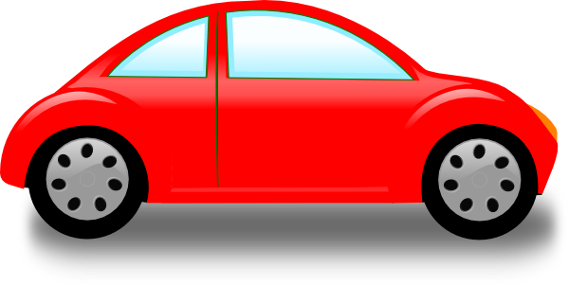

Vehicle Collision Detection and Warning Using Arduino Controller
Careful man…
3 Cars Ahead

Slide 2
Project Members:
Rajesh Reddy Gundupalli 15699A0538 CSE
Sowmya Sree Siriguppa 15699A04I7 ECE
Sai Vamsi Krishna S 15691A04H0 ECE
Sunil Kumar P 15699A0223 EEE
Manjusri R 15699A0449 ECE
Project Supervisors:
Name Designation Department Email
Dr. Venningston K, Associate Professor, M.E., Ph.D.
Department of Computer Science and Engineering
drveningstonk@mits.ac.in
Dr. Karthikeyan M, Senior Assistant Professor
Department of Electronics and Communication Engineering
karthikeyanm@mits.ac.in

Slide 3
What We're gonna Discuss?
Objective
Tools
Components
Project Explanation
Problems
Statistics
Solution
Applications

Slide 4
Objective:
As the usage of vehicles increased, the rate of accidents and the Dearth rate of people due to accidents also increased drastically. This system (project) warns the driver about the chances of accidents by voice based or screen (Graphics) based instructions.
In this system, we are using GPS (Global Positioning System) to which a SIM (Subscriber Identity Module) is interfaced. The data collected from GPS is sent through GSM (Global System for Mobile Communication) to the web server. The server will interact/warn driver through a dedicated device in the vehicle.
The SIM used here must have 3G/LTE by the service provider to send and receive data from the server. This kind of system warns driver effectively about the vehicles approaching towards and also distance between the vehicles. The main aim of this project is to reduce the number of accidents and save lives.

Slide 5
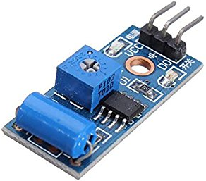
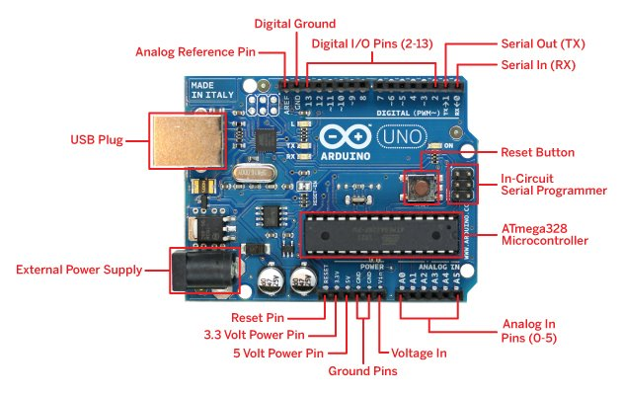
Components:
ARDUINO Uno
GSM
GPS
Vibration Sensors / Piezoelectric sensor
Notes:
https://store.arduino.cc/usa/arduino-uno-rev3

Slide 6
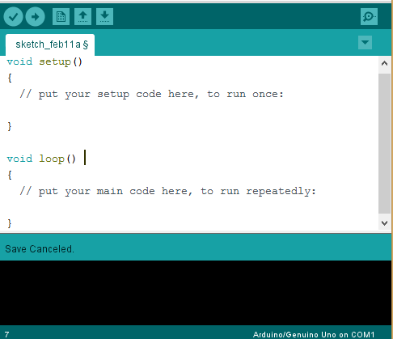
Tools:
ARDUINO IDE
DataBase
Embedded C (Programming)

Slide 7
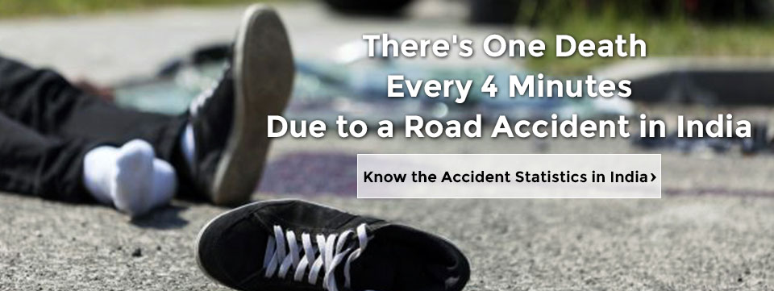
Project Explanation:
Problems:
Think About the WORLD?

Slide 8
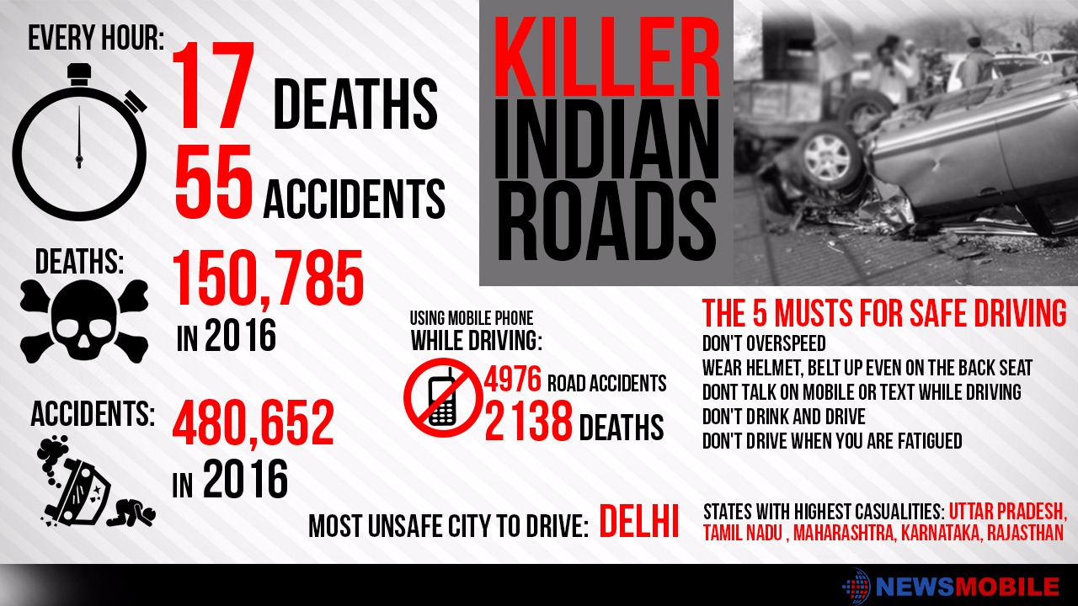
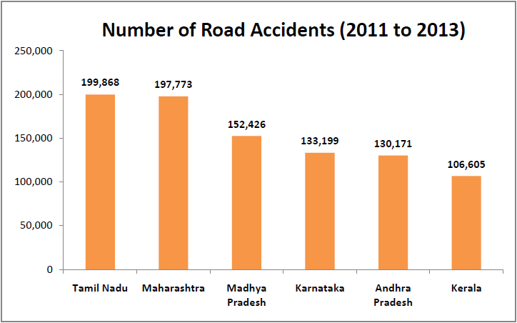
Statistics
Project Explanation:

Slide 9
Solution:
Project Explanation:
What if a device in a vehicle alerts Driver about Approaching Vehicle
The GPS in the vehicle continuously sends data to the cloud
If a vehicle Approaches near by to another vehicle, The System Alerts Driver
What if the vehicle itself communicates with Ambulance or Police Station, If an Accident occurred
The Vibration Sensors / Piezoelectric sensor detects the Accident and signal is sent through GSM

Slide 10


Project Explanation:
Cloud
Network
Network
I’m Approaching you by 100 mts
I’m Approaching you by 100 mts

Slide 11
Block Diagram
Cloud
Network
Arduino
UNO
Microcontroller
GPS
Interfacing Device
Vibration Sensor
GSM

Slide 12
Applications:
Accidents will be Reduced
Safe Transportation
Prevents Death's due to Road Accidents
Reporting to near by Hospital and Police Station about Accident

Slide 13


